Slide 1
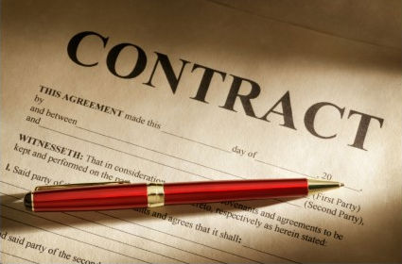
Ch. 7 – How Contracts Arise
Review Presentation

Slide 2
Two Elements of a Crime
Criminal Act
Required State of Mind

Slide 3
4 Elements of a Tort (Negligence)
Duty of Care
Breach of Duty
Proximate Cause
Actual Harm

Slide 4
6 Elements of a Contract
Offer
Acceptance
Genuine Agreement
Consideration
Capacity
Legality

Slide 5
Contract that is legally binding and fully enforceable.
Valid contract

Slide 6
Proposal by one party that he or she is willing to enter into a contract.
Offer

Slide 7
Contract that has no legal effect.
Void contract

Slide 8
Any agreement enforceable by law.
contract

Slide 9
Contract that comes about by the acts of the parties.
Implied in fact contract

Slide 10
Unqualified agreement by the offeree to be bound by the offer.
acceptance

Slide 11
Offer that has been changed by the offeree.
counteroffer

Slide 12
Contract stated in oral or written words.
Express contract

Slide 13
Contract in which both parties make promises.
Bilateral contract

Slide 14
Contract in which one party makes a promise in exchange for an act.
Unilateral contract

Slide 15
An offer must fulfill these 3 requirements.
Seriously intended
Definite and certain
Clearly communicated

Slide 16
5 Ways an offer comes to an end
Revocation
Rejection
Counteroffer
Expiration of time
death or insanity

Slide 17
Contracts are classified in 4 ways
Valid, void, voidable, or unenforceable
Express or implied
Bilateral or unilateral
Oral or written

Slide 18
Anne Samuels offered John Goodwin $25 if Goodwin would polish her car. Goodwin said nothing but started to work and polished the car. Is there a contract?
Yes – unilateral contract consists of an offer that is accepted by an act.

Slide 19
Annette Ramey, a sales representative for the Carlin Boat Company, wrote to Harry Duffin, offering to sell him a boat for $600 and agreed to hold the offer open for one week. Two days later, before Duffin made an acceptance, the boat company withdrew its offer. Could the company legally do this?
No – This is a firm offer.

Slide 20
Arlene Burns, a dealer in preowned cars, called Sam Firman and offered to sell him a preowned car for $2000. Firman told her he wanted to think it over and would let her know later. That afternoon Firman sent Burns a letter by express mail saying that he would buy the used car. Did this result in a valid contract?
Yes – An offer to make a contract can be accepted in any manner reasonable under the circumstances.

Slide 21
Bob Keefer wrote to Ed Ramirez offering to sell him the restaurant that Keefer owned. Ramirez wrote back to Keefer accepting the offer. He mailed the letter of acceptance on March 17 at 10:30 am and Keefer received it on March 18 at 11:00 am. Keefer had decided to revoke his offer, however, and had mailed a second letter to Ramirez on March 16 at 11:00 am, which stated his decision to revoke. Ramirez received this letter on March 17 at 10:00 am. Was there a contract?
No – The revocation took effect on March 17 at 10:00 am when it was received, one half hour before the acceptance was mailed.

Slide 22
Betty Allen offered to sell Cynthia Blaustein her skis for $100. She wrote to Blaustein, saying, “If I do not hear from you in two weeks, I will assume that you accept my offer.” If Blaustein does not answer, must she pay Allen $100 for the skis?
No – A person cannot be compelled to speak or write in order to avoid a binding agreement and is under no obligation to reply to this offer.

